Slide 1

Internet of Things Elania Resources 4 April 2020
Perak Technology Academy

Slide 2
Elania Resources
Bumiputera company that provides services to develop mobile apps, websites, web applications and e-commerce
Established on March 4, 2015
Founded by 2 person who passionate in ICT and technology field.
Created Perak Technology to boost ICT and technology industries in Perak.
Link: https://elaniaresources.com

Slide 3
P3R4K
Professional Principal Provider Refinement For Knowledge (P3R4K)
Penyempurnaan Penyedia Utama Profesional Untuk Ilmu Pengetahuan
Diwujudkan oleh Elania Resources pada Tahun 2016
Memiliki seramai lebih dari 3000 orang ahli yang aktif di Telegram
Link: https://peraktechnology.com

Slide 4
Objektif P3R4K
Penyediaan Golongan Profesional Dalam Industri ICT dan Teknologi
Meningkatkan Kemahiran Golongan Belia Dalam Bidang Latihan dan Pembelajaran
Meningkatkan Industri ICT dan Teknologi Di Negeri Perak
Mengatasi Masalah Pengangguran Di Kalangan Golongan Belia Di Negeri Perak

Slide 5
Perak Technology Academy
Terbuka Kepada Seluruh Penduduk Di Negeri Perak Yang Berumur 18 Keatas
Dilaksanakan Secara Maya Samada Melalui Skype dan Google Classroom
Tenaga Pengajar Dari Kalangan Ahli Atau Jemputan Dari Agensi Luar
Pembelajaran Merangkumi Pelbagai Bidang ICT dan Teknologi

Slide 6
Internet of Things (IoT)
Object connected to the Internet
Communicate with each other
Connected with automated system
Sensors, actuators and devices
Gather information, analyse and create action
Communicate across different type of network
Independent of human action

Slide 7
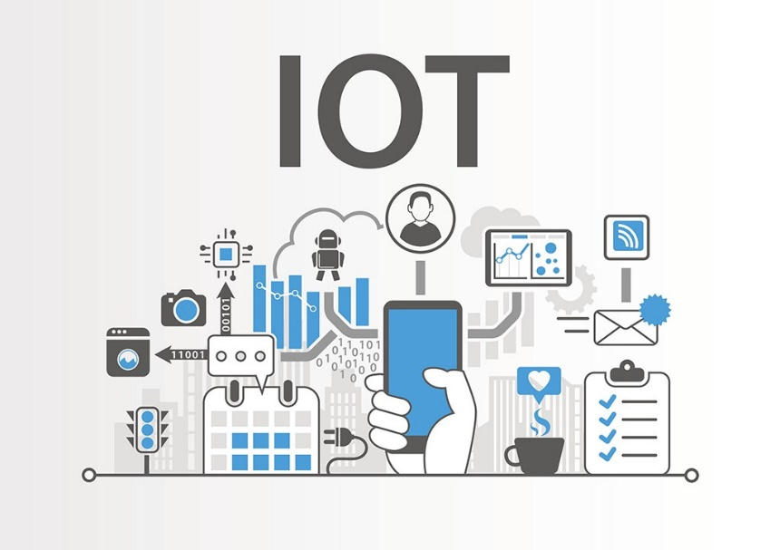
Technology
Super cheap small computer
Wireless network
Mobile network/5G
RFID, BLE & Infrared
Cloud computing
Information Security
Zigbee
Radio Frequency

Slide 8
Challanges
Data security
Power consumption
Cyber warfare
Multiple connected devices
Information communication
Multiple type of data
Artificial Intelligent

Slide 9
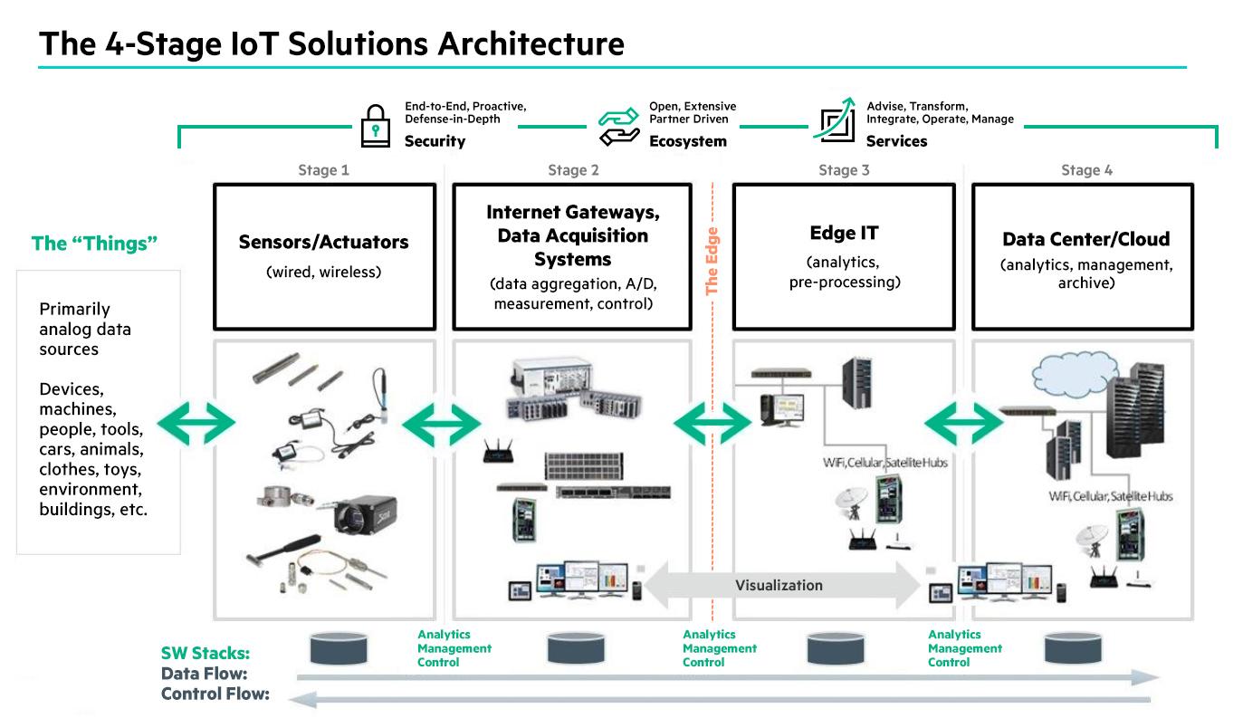
IoT Solutions Architecture

Slide 10
Example
Smart home
Driverless car
Intruder detection
Smart meter
Smart waste
Face recognition
Smart plantation

Slide 11
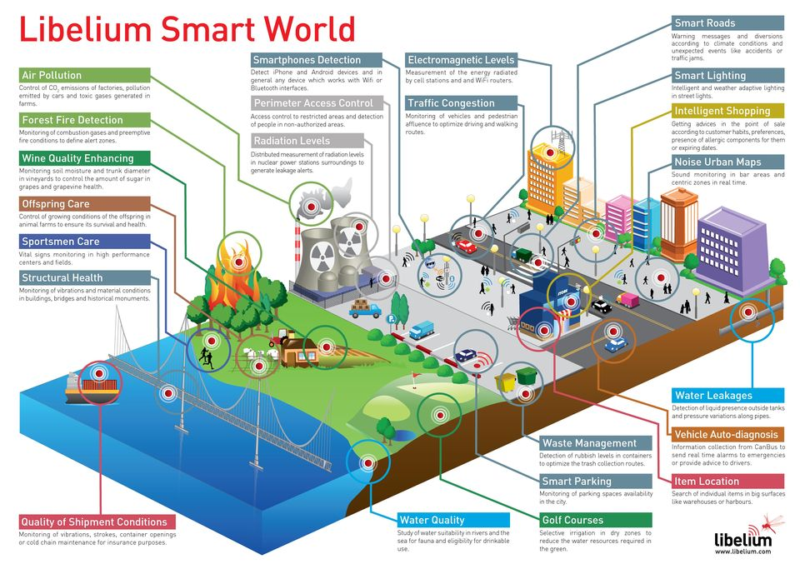
Libelium Smart World

Slide 12
Perak Technology Academy
https://academy.peraktechnology.com
https://t.me/peraktechnology
https://t.me/elaniaresources

